Slide 1
THE CODE OF ETHICS:
Our Promise of Professionalism
The REALTORS® Code of Ethics
Member Education Program

Slide 2
PG, Page 2
Course Objectives
1
Identify key aspirational concepts found in the Preamble to the NATIONAL ASSOCIATION OF REALTORS® Code of Ethics
4
Describe the professional standards process for enforcing the Code of Ethics, including the duty to arbitrate
2
Describe “general business” ethics, and compare and contrast the REALTORS® Code of Ethics with business ethics, generally
5
Identify critical elements of due process as they relate to Code enforcement
3
Describe the concepts established in Articles 1, 2, 12, and 17 of the Code of Ethics and identify possible violations of the Code specifically related to those Articles
6
Identify factors considered by hearing panels in procuring cause disputes.

Slide 3
Ice-Breaker Exercise
PG, Page 3
1. | Make only truthful and objective statements.
2. | Avoid the unauthorized practice of law.
3. | Participate in professional standards enforcement.
4. | Keep client funds in separate escrow accounts.
5. | Receive compensation from one party only with informed consent.
6. | Respect exclusive relationships.
7. | Cooperate with other brokers.
8. | Disclose present or contemplated interests in property.
9. | Treat all parties honestly.
10. | Arbitrate contractual disputes.
11. | Avoid using epithets or slurs against protected classes.
12. | Make your “true position” known when presenting offers.
13. | Be competent in your field of practice.
14. | Get transactional details in writing.
15. | Disclose pertinent facts.
16. | Disclose financial benefits from recommending products/services.
17. | Paint a true picture in advertising.

Slide 4
Ice-Breaker Answers
PG, Page 2
1. | Make only truthful and objective statements. | Article 15
2. | Avoid the unauthorized practice of law. | Article 13
3. | Participate in professional standards enforcement. | Article 14
4. | Keep client funds in separate escrow accounts. | Article 8
5. | Receive compensation from one party only with informed consent. | Article 7
6. | Respect exclusive relationships. | Article 16
7. | Cooperate with other brokers. | Article 3
8. | Disclose present or contemplated interests in property. | Article 5
9. | Treat all parties honestly. | Article 1
10. | Arbitrate contractual disputes. | Article 17
11. | Avoid using epithets or slurs against protected classes. | Article 10
12. | Make your “true position” known when presenting offers. | Article 4
13. | Be competent in your field of practice. | Article 11
14. | Get transactional details in writing. | Article 9
15. | Disclose pertinent facts. | Article 2
16. | Disclose financial benefits from recommending products/services. | Article 6
17. | Paint a true picture in advertising. | Article 12

Slide 5
PART 1:
History of the Code of Ethics

Slide 6
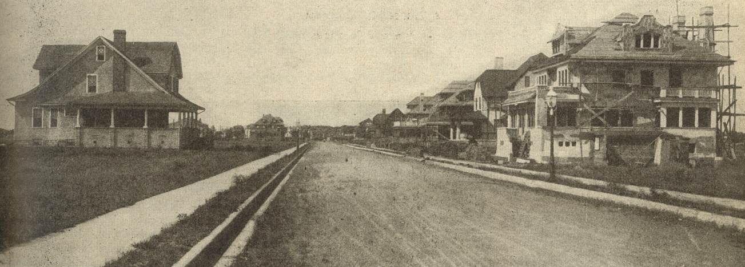
PG, Page 4
Pre-1900
No licensing of real estate practitioners
Speculation, exploitation, and disorder
Caveat emptor governed transactions.

Slide 7
NATIONAL ASSOCIATION OF REALTORS® Formed in 1908
PG, Page 4
Known then as the National Association of Real Estate Exchanges

Slide 8
PG, Page 4
Code of Ethics Adopted in 1913
Established professional standards for conduct
First ethical code for business after medicine, engineering, and law
Focused on:
Service to the public
Commitment to professionalism
Included “Duties to Clients” and “Duties to Other Brokers”

Slide 9
PG, Page 4
The Code of Ethics was the basis for later-adopted license laws.

Slide 10
PG, Page 4
The Code of Ethics:
Since its inception, the Code has required:
Arbitration of contractual disputes between/among REALTORS®
Respect for other brokers’ exclusive relationships with clients
Cooperation between/among REALTORS®

Slide 11
PG, Page 5
Business Ethics, NAR Code of Ethics, and Pathways to Professionalism

Slide 12
PG, Page 5
Business Ethics
Industry codes
Company Policies
Individual moral values
Business ethics and legal standards

Slide 13
PG, Page 6
REALTORS® Share One Common Characteristic:
Regardless of real estate business specialty (such as appraisal, property management, etc.), all REALTORS® are bound by the Code of Ethics.

Slide 14
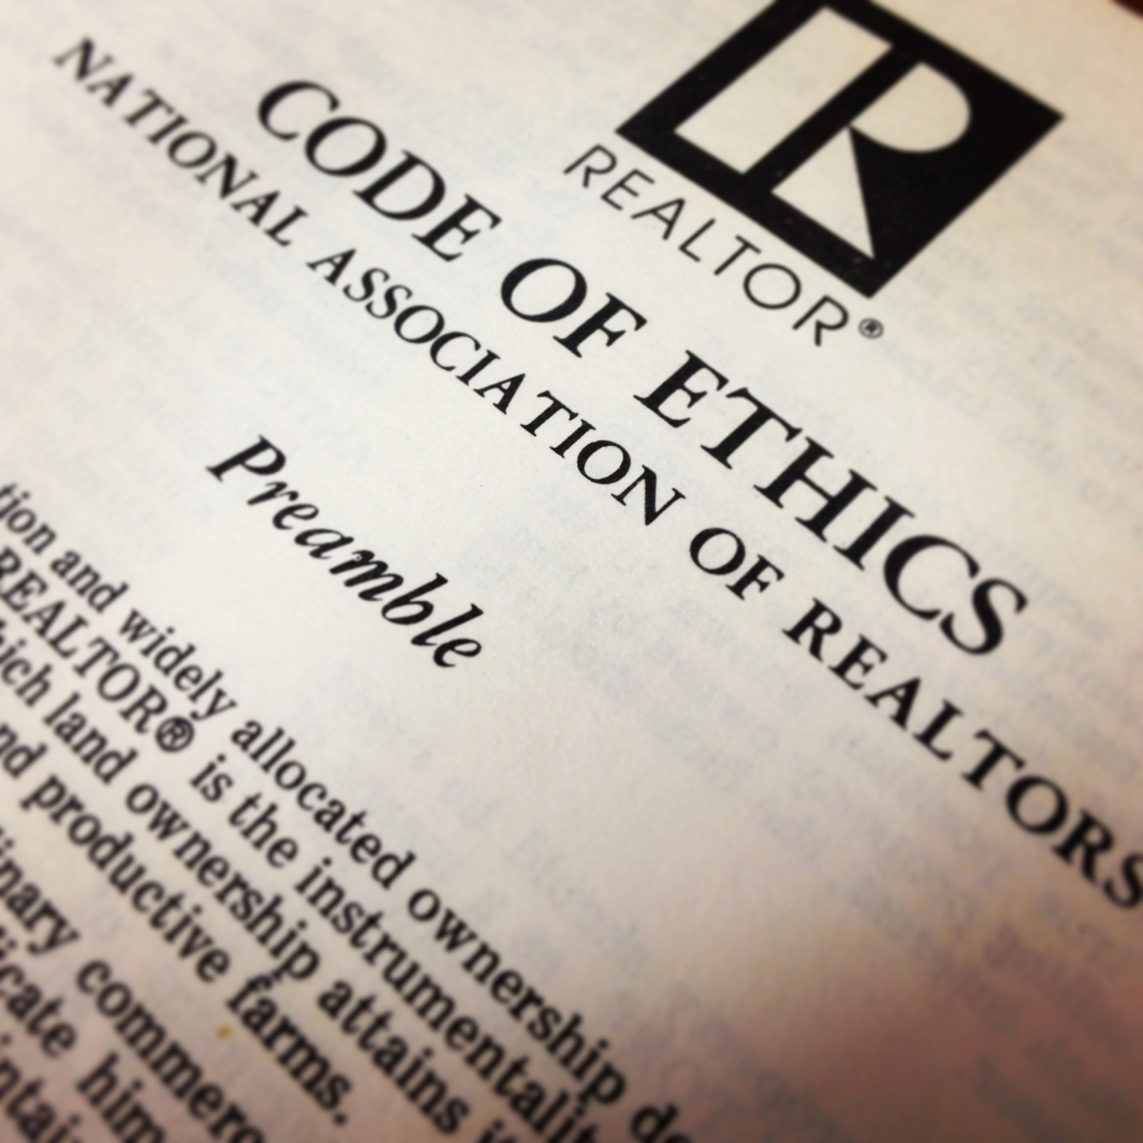
PG, Page 6
Preamble to the Code of Ethics

Slide 15
PG, Page 6
Under all is the land…

Slide 16
PG, Page 6
Golden Rule
Whatsoever ye would that others should do to you, do ye even so to them.

Slide 17
PG, Page 6
Alleged violations of the Preamble may not be the basis for disciplining a REALTOR®

Slide 18
Structure of the Code of Ethics
PG, Page 7
Three Sections
Duties to Clients & Customers
Duties to Public
Duties to Other REALTORS®

Slide 19
Structure of the Code of Ethics
PG, Page 7
17 Articles
Each section is comprised of Articles, which are broad statements of ethical principles
Only Articles of the Code may be violated

Slide 20
Structure of the Code of Ethics
PG, Page 7
Standards of Practice
Support, interpret, and amplify each Article
May not be charged, but may be cited in support of an alleged violation

Slide 21
PG, Page 7
How the Code of Ethics Evolves
Amendments are made during the REALTORS® Legislative Meetings and NAR NXT – The REALTOR® Experience.
Revisions require approval by the NAR Professional Standards Committee and Board of Directors.
Interpretations and Procedures Subcommittee of the Professional Standards Committee recommends many of the changes.

Slide 22
PG, Page 7
Any change to an Article of the Code must be approved by the NAR Delegate Body.

Slide 23
PG, Page 8
The Code and the Law
The Code of Ethics:
Must be reasonably construed with the law
Imposes duties above and in addition to duties imposed by law or regulation
Restates certain fundamental legal principles

Slide 24
PG, Page 9
Pathways to Professionalism
Three Sections
Respect for the Public
Respect for Property
Respect for Peers

Slide 25
PG, Pages 9
Pathways to Professionalism

Slide 26
PG, Pages 10 & 11
Pathways to Professionalism Exercise
Service
Courtesy
Etiquette

Slide 27
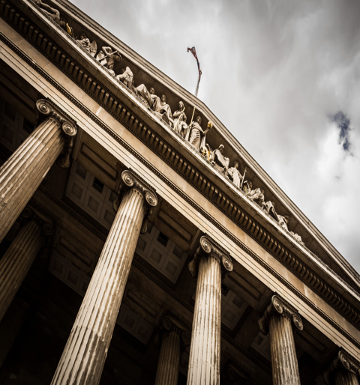
PART 3:
Enforcement of the Code of Ethics

Slide 28
PG, Page 13
Enforcement of the Code of Ethics
Every association is responsible for enforcing the Code.
This includes providing mediation and conducting ethics and arbitration hearings.
Only REALTORS® and REALTOR-ASSOCIATES® are subject to the Code.

Slide 29
PG, Page 13
Enforcement of the Code of Ethics
An association where someone holds membership OR gains MLS access has jurisdiction to process ethics complaints and arbitration requests filed against that individual.
Associations do NOT determine violations of law and regulation.

Slide 30
PG, Page 13
Association Dispute Resolution
Option #1 – Informal
Ombudsman
Mediation
Option #2 – Formal
Ethics Complaints
Arbitration Requests

Slide 31
PG, Page 14
Informal Dispute Resolution
Ombudsman Program
Only available if offered by a local association.
Voluntary process.
Ombudsmen may field and respond to inquiries and complaints, solicit responses, and meet with disputing parties.
Disputants reserve the right to file a formal ethics complaint.

Slide 32
PG, Page 14
Role of the Ombudsman
The ombudsman’s role is primarily communication and conciliation, not adjudication.
Ombudsmen DO:
Anticipate, identify, and resolve misunderstandings and disagreements before matters ripen into disputes and charges of unethical conduct.
Ombudsmen DO NOT:
Determine whether ethics violations have occurred or who is entitled to what amount of money.

Slide 33
PG, Page 14
Ombudsmen can help repair breakdowns in communication and develop acceptable resolutions between disputing parties.

Slide 34
PG, Page 16
Informal Dispute Resolution Mediation
Voluntary process, unless the Association (at its discretion) requires its REALTOR® members to mediate per Article 17.
Enabling bylaw provisions (found in Article VII of the NAR Model Bylaws for Local Member Boards) must be adopted to mandate mediation.

Slide 35
PG, Page 16
Informal Dispute Resolution Mediation
Disputing parties meet with a mediator appointed by the association.
Parties create a mutually acceptable resolution of the dispute, rather than go before an arbitration hearing panel.

Slide 36
PG, Page 17
Mediation
Preferred dispute resolution tool by the REALTOR® organization.
Must be available to all REALTORS®
May offer before OR after grievance committee’s review.
If offered before, must be offered again after the grievance committee determines the matter is arbitrable and forwards on to a hearing.

Slide 37
PG, Page 17
Mediation
If a resolution is reached, parties sign an agreement containing the terms of the settlement, and no arbitration hearing is held.

Slide 38
Differences Between Mediation and Arbitration
PG, Page 17
Mediation | Arbitration
Low cost | Moderate cost
Little delay | Moderate delay
Maximum range of solutions | Win / loose / split
Parties control the outcome | Arbitrators control the outcome
Uncertain closure | Definite closure
Maintains / improves relationships | May harm relationships

Slide 39
PG, Page 18
WHO can file an ethics complaint?

Slide 40
PG, Page 18
Grievance Committee in Ethics
Is there a POTENTIAL violation of the Code of Ethics?

Slide 41
PG, Page 18
Ethics Hearing Panel
Following a hearing, the panel decides whether the Code of Ethics has been violated, proven through Clear, Strong, and convincing evidence.
If a Code violation is found, then the panel also determines the discipline.

Slide 42
PG, Page 18
Authorized Discipline
Letter of warning
Letter of reprimand
Education
Fine, not to exceed $15,000
Probation of one year or less
Suspension of not less than 30 days, nor more than one year
Expulsion from membership for one to three years
Suspension or termination of MLS privileges

Slide 43
PG, Page 18
The primary emphasis of discipline is educational, to create a heightened awareness of and appreciation for the Code of Ethics.

Slide 44
PG, Page 19
Filing an Arbitration
Request
Arbitration is conducted under Article 17 of the Code of Ethics AND under a state’s arbitration statute (if any).
Article 17 provides that arbitration occurs under the following circumstances…

Slide 45
PG, Page 19
Arbitration and Article 17
Contractual or specific non-contractual disputes, as defined by Standard of Practice 17-4
Between REALTORS® (principals)
Arising out of their relationship as REALTORS®
NOTE: Clients also may arbitrate with their REALTOR® principals.

Slide 46
PG, Page 19
Grievance Committee in Arbitration
Is there an arbitrable issue?
(That is, a money dispute, typically concerning which REALTOR® is entitled to compensation in a transaction.)

Slide 47
PG, Page 19
Arbitration Hearing Panel
Conducts full “due process” hearing.
Comprised of members from an association’s professional standards committee
After a hearing, the panel decides which party is entitled to the award, based on a preponderance of the evidence.

Slide 48
PG, Page 19
Payment of an Arbitration Award
An unpaid award typically may be judicially enforced.
Some associations require that award monies be deposited with the association, pending review of the hearing process or during a legal challenge.

Slide 49
PART 4:
Concepts of Procuring Cause in an Arbitration

Slide 50
PG, Page 21
Arbitration Guidelines
Found in the Code of Ethics and Arbitration Manual.
Guide hearing panels in resolving arbitrable issues.
Focus primarily on procuring cause as the basis for resolving most compensation disputes.

Slide 51
PG, Page 21
Procuring Cause Factors
No pre-determiners.
Consider the entire course of events.
Writing an offer, making the first showing, or an agency relationship, in and of themselves, do not necessarily determine procuring cause or entitlement.

Slide 52
PG, Page 21
Procuring Cause
The proximate cause; the cause originating a series of events which, without break in their continuity, result in the accomplishment of the prime object.
– Black’s Law Dictionary, Fifth Edition

Slide 53
Procuring Cause
PG, Page 21
It is the squirrel that shakes the branch and not the squirrel that gathers the nut.
- Arkansas Supreme Court

Slide 54
PG, Page 22
PART 5:
Summaries and Case Studies of Selected Articles of the Code of Ethics

Slide 55
PG, Page 19
Article 1
Protect and promote your client’s interests.
This obligation to your client is primary.
Treat all parties honestly.
Standard of Practice 1-2 defines terms such as “client”, “customer”, “agent”, and “broker”.

Slide 56
Article 1 Case Study
(Based on Case Interpretation #1-26)
PG, Page 20 & 21

Slide 57
PG, Page 25
Article 2
Avoid exaggeration, misrepresentation, and concealment of pertinent facts about the property or the transaction.
No obligation to discover latent defects, matters outside the scope of license, or matters confidential under agency or non-agency relationships.

Slide 58
Article 2 Case Study
(Based on Case Interpretation #2-7)

Slide 59
PG, Page 28
Article 12
Requires truth and honesty in ALL real estate communications.

Slide 60
PG, Page 28
Article 12
Be honest and truthful in real estate communications.
Present a “true picture” in advertising, marketing, and other representations.
Ensure that your status as a real estate professional is readily apparent in advertising, marketing, and other representations.

Slide 61
Article 12 Case Study #1
(Based on Case Interpretation #12-17)
PG, Page 26 & 27

Slide 62
Article 12 Case Study #2
(Based on Case Interpretation #12-19)
PG, Page 28 & 29

Slide 63
PG, Page 30
Article 17
REALTORS® (principals) must arbitrate contractual and specific non-contractual disputes, as defined by SOP 17-4.
Clients may invoke mandatory arbitrations with their REALTORS ® (principals).
REALTORS ® are obligated to cause their firms to arbitrate.

Slide 64
Article 17 Case Study #2
(Based on Case Interpretation #17-1)
PG, Page 31 & 32

Slide 65
PG, Pages 37
PART 6:
Pathways to Professionalism and Marketing the Code of Ethics

Slide 66
PG, Pages 40 - 45
When to Look at the Code; Using the Code in all Communications
The Code of Ethics is a great risk reduction tool.
Let buyers and sellers know REALTORS® have agreed to the higher standards established in the Code of Ethics, as compared to license law.
REALTORS® will act in their client’s best interests.
Use the Pledge of Performance in buying and listing presentations (available at nar.realtor).
Wear and display your REALTOR® pin, explaining REALTORS® are committed to professionalism since 1913.
Make the Code a key component in all professional correspondence.

Slide 67
Pathways to Professionalism
Three Sections, including 30 professional courtesies
Respect for Public
Respond to inquiries promptly; show courtesy and respect.
Respect for Property
Leave the property how you found it; also, avoid eating, drinking, smoking or using facilities (unless given permission).
Respect for Peers
Notify the listing broker if there appears to be inaccurate information in the listing, and remember real estate is a reputation business. What you do today may affect your reputation and business for years to come.

Slide 68
Case Study #1
(Based on Pathways to Professionalism)

Slide 69
Case Study #2
(Based on Pathways to Professionalism)

Slide 70
Conclusion

Slide 71
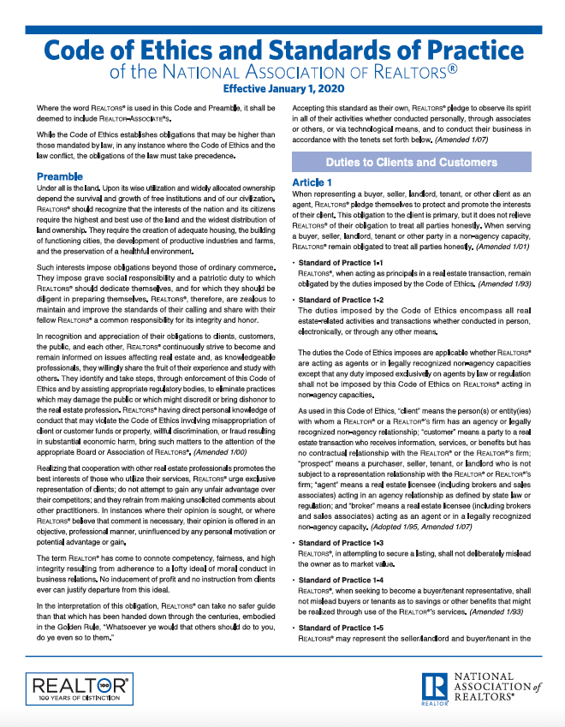
PG, Page 30
The REALTORS® Code of Ethics
Protects the buying and selling public.
Promotes a competitive real estate marketplace.
Enhances the integrity of the industry.
Is OUR promise of performance.
Is OUR promise of professionalism.

